Slide 1
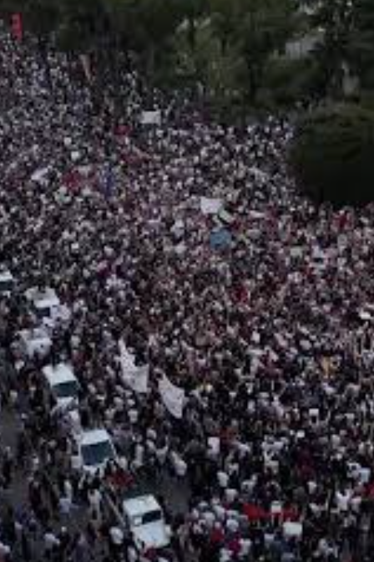

Protection of journalists in the context of Public order : European standards and practices
Pauline Adès-Mével
Working Group for Chapter 24: Justice, Freedom, Security
Cooperation Police–Media–Civil Society: Freedom of Speech and Public Security in the Process of European Integration
10 June 2026, 11:00 – 12:30

Slide 2
Agenda
1. Introduction : Why this issue matters
2. Albania's progress : institutional frameworks exist
3. Remaining challenges : moving from law to practice
4. European good practices : what can Albania learn from them ?
5. Recommendations for Albania
6. Next steps : a monitoring mechanism ?

Slide 3
Introduction
Rule of law, freedom of expression and democratic credibility
Public order vs. freedom of the press
Challenge: implementation, not only adoption of protocols

Slide 4
Albania's Progress
• Journalist safety guidelines adopted
• Designated contact points
• Specialized prosecutors
• Institutional progress deserves recognition

Slide 5
The Remaining Challenge
• 42 violations recorded in 2025
• 40.6% reported threats/intimidation
• 68% reported reporting restrictions
• Low awareness and institutional trust

Slide 6
From Law to Practice
• Are journalists identified correctly?
• Are liaison officers present?
• Are incidents investigated rapidly?
• Are women journalists adequately protected?

Slide 7
European Standards
• Council of Europe CM/Rec(2016)4
• Journalists must not be confused with demonstrators
• Prevention, coordination and training are required

Slide 8
Examples of Good Practices
Germany: specialised safety training for high-risk events.
Sweden: dialogue police and regular communication.
Netherlands: comprehensive support and incident reporting.
France: police liaison officers during demonstrations.
Croatia & Ireland: clear protocols and dedicated contact points.

Slide 9
Recommendations for Albania
Strengthen mandatory police training.
Create permanent police & media liaison mechanisms.
Ensure rapid, transparent accountability for incidents.
Increase awareness of existing protection mechanisms.
Use the 2027 local elections as a practical readiness exercise.

Slide 10
2027 Local Elections
Nationwide readiness exercise
Outreach beyond Tirana
Regional training sessions
Test protocols in real conditions

Slide 11
Conclusion
Move from formal compliance to implementation
Protocols must be known, trusted and used
Protecting journalists protects democracy
A monitory mechanism ?

