Slide 1

Academy of the Police Force in Bratislava
Educational process and key challenges

Slide 2
Academy of the Police Force in Bratislava
34 years since the founding
University type of educational institution providing education in bachelor, master and PhD. degree
Two main study programmes:
Protection of people and property
Security public - administration services

Slide 3
Protection of people and property
Description of the Study Programme: The graduate possesses a comprehensive knowledge of legal theory and its application in the security protection of persons and property. They are equipped with the theoretical background and practical skills necessary to design and implement effective security and legal measures. The graduate is capable of analyzing security environments, managing risks, and responding to emergency and crisis situations. They can also lead teams, coordinate activities, and apply their expertise in both national and international security contexts.
Internal and external study programme
Police officers students
Internal students bachelor degree: 276
External students bachelor degree: 245
Internal students master degree: 30
External students master degree: 246
Theory and practice - Authorization to operate a service vehicle, certification for the use of a alco tester, drug tester, laser speed measuring device, TASER, and selected firearms.

Slide 4
Security public - administration services
Description of the Study Programme: The graduate possesses comprehensive knowledge of legal theory and its application in security and legal services within public administration. They are equipped with the skills to design and implement effective legal, organizational, and security measures. The graduate can analyze the administrative-security environment, manage risks, and respond to crisis situations. They are also capable of leading teams, coordinating activities, and applying their expertise in both national and international contexts.
Internal and external study programme
Civil students
Internal students bachelor degree: 127
External students bachelor degree: 74
Internal students master degree: 75
External students master degree: 35

Slide 5
Departments
Police Sciences Department
Department of the European Integrated Border Management
Criminal Police Department
Investigation Department
Criminalistics and Forensic Science Department
Criminology Department
Criminal Law Department
Administrative Law Department
Information Science and Management Department
Public Administration and Crisis Management Department
Public Law Department
Private Law Department
Social Sciences Department
Foreign Languages Department
Physical Education and Sports Department

Slide 6
Academy of the Police Force in Bratislava Language education
The Department of Languages ​​provides general and professional communication instruction in English, German, and Russian for both fields of study. The content of teaching a professional foreign language is the development of language skills with a focus on the specific use of foreign languages ​​as a means of communication in police practice and public administration.
Bachelor's degree and Master's degree program:
Foreign language I – English, German, Russian - Introduction to professional terminology
English for Police I
English for Police II
English for Public Administration II
English for Public Administration II

Slide 7
Academy of the Police Force in Bratislava Longlife learning programs
Department of Lifelong Learning:
Specialized police studies
Special interrogation rooms for child victims and other particularly vulnerable victims of crime
Police management training courses
Specialized courses for members of the National Security Office
Course for Police attache
Future: Special courses on nonverbal comunication for operatives and investigators
Specialized course focused on the investigation of corruption (for operational and investigative personnel)

Slide 8
Specialized police studies
The aim of specialized police study is to acquire the knowledge, abilities, and skills necessary for the performance of the function of an investigator of the Police Force or for the performance of a function in the law enforcement service and to enable its participants to obtain a specialized police education in this area of ​​the Police Force's activity.

Slide 9
Police management training courses
The project's primary goal is, through the implementation of theoretical knowledge and practical skills in the system of lifelong education of police management, to create essential prerequisites for effective and high-quality performance of managerial functions at various levels of management of the police organization.
The course is organized in a daily form of study lasting four days, with 32 teaching hours, 30 hours of theoretical teaching, and 2 hours of practical instruction for general management skills. The course ends with a final exam.

Slide 10
Specialized courses for members of the National Security Office
The specialization study aims to provide the necessary general and specific professional knowledge and skills for the performance of professional activities and to enable the acquisition of specialized police education (specialized professional education for members of the National Security Office).

Slide 11
Course for Police attache
The following departments participate in the intra-departmental pre-departure training of police officers within the Police Academy in Bratislava:
Department of Languages ​​(language training)
Department of Criminal Police (theoretical part),
Department of Police sciences (theoretical part)
Department of European Integrated Border Management,
Department of Criminal law (theoretical part).

Slide 12
Academy of the Police Force in Bratislava
Science and Research
Why are science and research important?
Science and research create space for innovation and modernization. Through the active involvement of academics and researchers, it is possible to focus on specific areas that reflect the real needs of police and security practice. The aim is not only to foster professional discussion on key issues, but above all to deliver practical, applicable outcomes that provide real value and are effectively used in policing and security environments.

Slide 13
EU Projects
Projekt WATCCH
Podpora v boji proti prejavom radikalizmu a extrémizmu a zvýšenie efektivity preventívnych a represívnych opatrení v boji proti korupcii
PODPORA V OBLASTI KYBERNETICKEJ A INFORMAČNEJ BEZPEČNSTI NA AKADÉMII POLICAJNÉHO ZBORU V BRATISLAVE
Národný projekt Zvýšenie odolnosti Slovenska voči hybridným hrozbám pomocou posilnenia kapacít verejnej správy
FULL-PROOF „Zaručenie riadneho priebehu trestného konania prostredníctvom posilňovania procesných práv podozrivého a obvineného“
Centrum excelentnosti bezpečnostného výskumu
Projekt GODIAC
Projekt EUSEC II
Projekt THE HOUSE
Národný projekt Špeciálne výsluchové miestnosti pre detské obete a ďalšie obzvlášť zraniteľné obete trestných činov
Zlepšenie ochrany práv obetí – posilnenie kapacít a postupov boja proti násiliu na ženách a domácemu násiliu
Projekt STRONG
Projekt popAI
Bridge -101084355
Projekt IN2PREV – Erasmus + KA220-ADU-EC004C7E

Slide 14
Academy of the Police Force in Bratislava
Increasing Slovakia’s resilience to hybrid threats by strengthening public administration capacities
As part of Activity 2 of the national project, educational activities were primarily conducted for students of the Police Academy in Bratislava. The educational activity involved editing and supplementing thematic plans and information sheets within the subjects listed below. A total of 605 students participated during lectures in updated subjects.
Updated subject:
Information management, Criminology, Criminalistics, Crisis management, Modern methods of information processing, Investigation.

Slide 15
Academy of the Police Force in Bratislava
As part of Activity 2 of the national project, the lifelong learning program "Increasing Slovakia's Resistance to Hybrid Threats by Strengthening the Capacities of the Police Force and Public Administration" was created.
A total of 1,220 participants, including 760 members of the Police Force and 460 employees of the public administration, participated in the education within the lifelong learning program. The structure of the educational program in the lifelong education system had the following concept.

Slide 16
Content
Modul | Day | Lectures | Time | Form | Content
An introduction to hybrid threats | 1 | 1_2 | 7:30 - 9:05 | online | Introduction, basic characteristics of hybrid threats, terms and starting points related to the issue of hybrid threats.
 | 1 | 3_4 | 9:15 - 10:50 | online | Past and present use of hybrid threats.
 | 1 | 5_6 | 11:00 - 12:35 | online | Disinformation, propaganda and information operations.
 | 1 | 7_8 | 13:30 - 15:05 | online | Initiatives, measures and entities with competence in the field of combating hybrid threats at the level of the European Union and the Slovak Republic.
Hybrid threats - a specialization designed for members of the Police Force | 2 | 1_2 | 7:30 - 9:05 | online | Legal aspects of hybrid threats.
 | 2 | 3_4 | 9:15 - 10:50 | online | The cyber dimension of hybrid threats in relation to Police Force. Multi-institutional cooperation and cooperation in the field of prevention and elimination of hybrid threats.
Hybrid threats - specialization for Slovak public administration employees | 2 | 1_2 | 7:30 - 9:05 | online | Past, present and future extraordinary events that can be misused for hybrid effects on public administration entities and employees.
 | 2 | 3_4 | 9:15 - 10:50 | online | The cyber dimension of hybrid threats in relation to public administration.
Summary and final exam | 2 | 5_6 | 11:00 - 12:35 | online | HH indicators and their collection system.
 | 2 | 7_8 | 13:30 - 15:05 | online | Feedback on education, questionnaire collection. Final test.

Slide 17
Special interrogation rooms for child victims and other particularly vulnerable victims of crime
Objectives of the project:
Creation of a space for victims of crimes with a special need for protection against further harm to the victim during criminal proceedings.
Increasing the professional competence of members of the Police Force in the field of investigation.
Main activities
1. Establishment of special interrogation rooms
Realization of construction modifications of interrogation rooms
Interior equipment of interrogation rooms
Technical equipment of interrogation rooms
2. Professional training of members of the Police Force
Creating a methodology for professional training and special instruction
Implementation of professional training

Slide 18

Special interrogation rooms for child victims and other particularly vulnerable victims of crime

Slide 19
Academy of the Police Force in Bratislava Subject: Protection of human rights
The student will acquire theoretical and methodological knowledge about the development and categories (their meaning) of fundamental rights and freedoms by completing the subject. He has the necessary expertise in the field of protection of human rights and fundamental freedoms. He will acquire knowledge of the legal (international, national) regulation of human rights and obtain information about the judicial and institutional system of their protection, which he can subsequently apply to implement and protect fundamental rights and freedoms. He understands the field of study's moral, ethical, and legal context. He applies them in practical activities in the protection of human rights and fundamental freedoms as one of the areas of security science.

Slide 20
Academy of the Police Force in Bratislava
Service actions performed by a police officers and the application of a principle of appropriateness from the perspective of criminal and administrative law.
One of the essential outputs was the development of a new methodology for official interventions in cooperation with the Training Department of the Presidium of the Police Force. The new methodology also includes videos with practical examples.
An essential result of the project is the creation and opening of a specialized classroom intended for theoretical and practical training in service interventions.

Slide 21
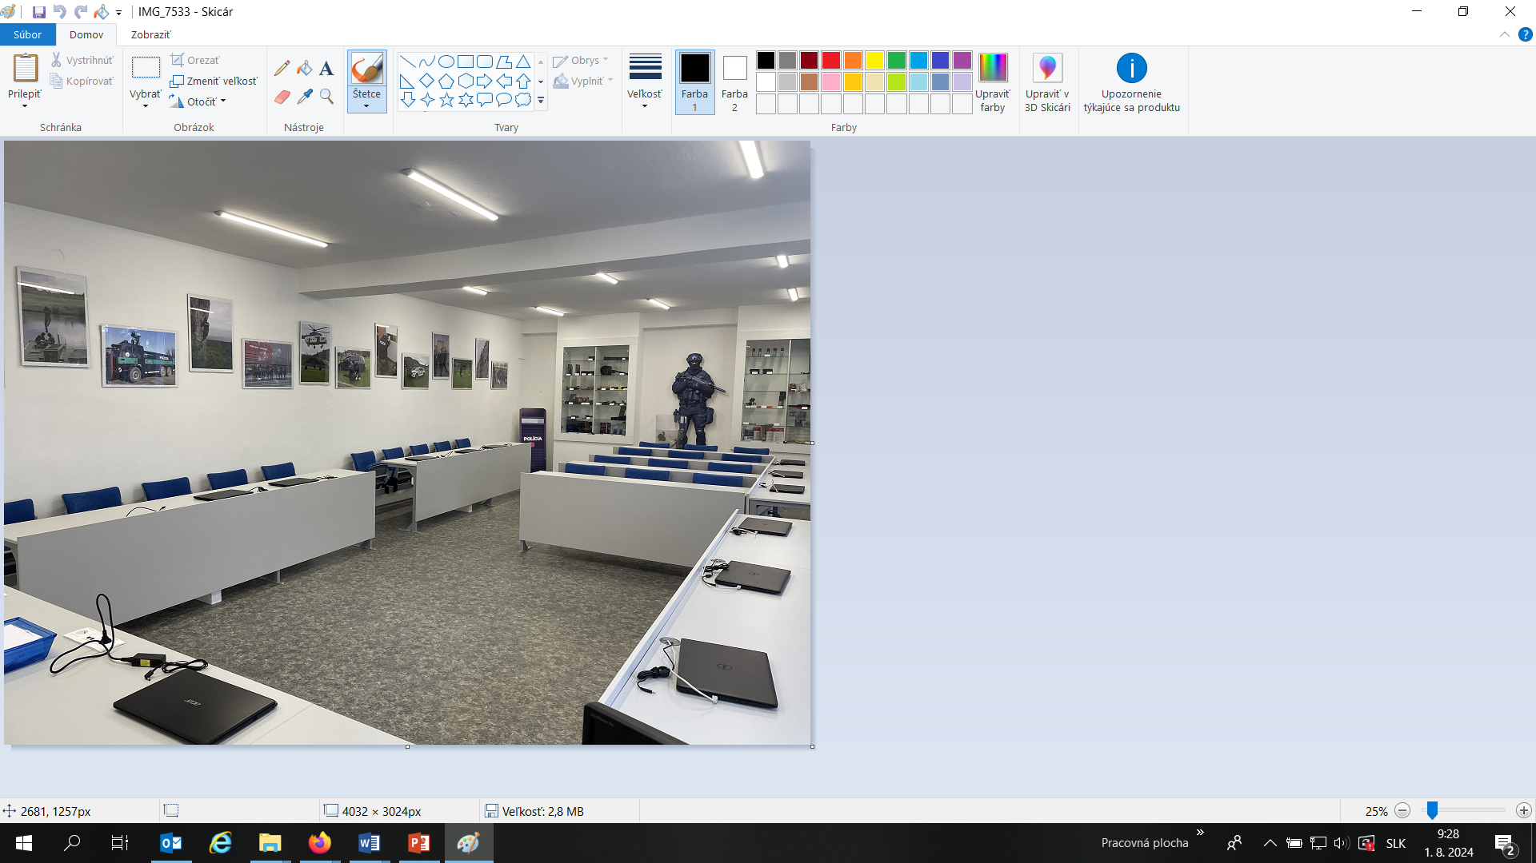
Academy of the Police Force in Bratislava

Slide 22
Erazmus +
The Academy of the Police Force in Bratislava has been awarded the Erasmus Charter for Higher Education (ECHE) for the entire duration of the Erasmus+ programme 2021–2027. The Erasmus Charter for Higher Education establishes a general quality framework for European and international cooperation activities that higher education institutions may carry out within the Erasmus+ programme.
Within the Erasmus+ programme, our university provides Learning Mobility of Individuals, including mobility opportunities for students, recent graduates, and doctoral candidates for study or traineeships, as well as staff mobility for teaching and training purposes.

Slide 23
Erazmus +
Partner Universities within the Erasmus+ Programme
Croatia Czech Republic Hungary Germany Poland Estonia Lithuania Bulgaria Romania Slovenia
Total number: 30 partner Universities

Slide 24
EU Strategic documents
Reasons for Introducing Changes in the Educational Process
Changing security environment in the EU
New forms and trends in crime
Increasing demands on police competencies
EU strategic documents
Aligning education with EU frameworks is essential.

Slide 25
SOCTA
Serious and Organised Crime Threat Assessment
A strategic analytical document of the EU
Prepared by Europol
Identifies key threats and crime trends
Serves as a basis for the EU Policy Cycle
Analysis of serious and organised crime
Identification of new and emerging threats
Basis for setting EU priorities
Strategic planning in the field of internal security
Education must reflect the outputs of SOCTA.

Slide 26
EMPACT
European Multidisciplinary Platform Against Criminal Threats
EU implementation tool
Implements priorities based on SOCTA
Multidisciplinary approach
Cooperation between EU Member States and EU agencies

Slide 27
Impact of SOCTA and EMPACT on the Educational Process
Updating course content
Development of analytical thinking
Linking theory with practice
Alignment with the needs of the Police Force of the Slovak Republic and the EU

Slide 28
LEED Platform
EU learning platform managed by CEPOL
Verified and up-to-date content
Unified approach to European education
Teachers are required to:
integrate LEED into teaching
use courses and webinars
recommend LEED activities to students
link LEED with course content

Slide 29
E-learning as a Component of the Education of Security Forces
The measures adopted during the COVID-19 pandemic also significantly affected university education. All higher education institutions responded to the situation by introducing online teaching, which replaced traditional face-to-face instruction. Gradually, this led to the development of the idea of formally integrating e-learning into the educational process.
The Academy of the Police Force in Bratislava is a specialized higher education institution that primarily trains members of the Police Force.
The decision was made that both academic staff and students would be able to use the unique LEED platform for e-learning activities, operated by the European Union Agency for Law Enforcement Training (CEPOL)

Slide 30
LEED Platform
Main Functions of the LEED Platform:
E-learning and blended learning – providing online courses, webinars, and virtual training activities coordinated by CEPOL.
Knowledge sharing – access to educational resources, research outputs, and policy-relevant materials related to EU security priorities (e.g., serious and organised crime).
Professional networking – facilitating interaction between law enforcement officers, instructors, and experts from EU Member States.
Support EU policies by aligning educational content with EU frameworks such as SOCTA and EMPACT, including intelligence-led policing.
Accessibility and standardisation – ensure all EU law enforcement officers have equal access to high-quality training.
The platform provides access to specialised e-learning courses, study materials, and up-to-date knowledge on law enforcement within the European Union. The use of this platform may contribute to modernising teaching, expanding academic staff's professional knowledge, and strengthening the international dimension of education at the Academy of the Police Force in Bratislava.

Slide 31
Academy of the Police Force in Bratislava
Through e-learning courses, students gain access to current professional knowledge in law enforcement, case studies from police practice, and opportunities to further develop their professional, language, and digital competencies in an international context.
Students benefit significantly from using the LEEd platform. By registering and using its resources, they gain advantages such as:
Access to specialised online courses in areas such as combating organised crime, terrorism, cybercrime, financial investigations, and border protection
The opportunity to become familiar with current trends and practices in law enforcement across European Union Member States
Access to professional materials and the expertise of specialists from various European security institutions
The opportunity to participate in an international educational environment and communicate with experts and students from other countries
Students can earn CEPOL certificates after successfully completing courses. These certificates may help their future security careers.
The expansion of knowledge beyond the standard curriculum, complementing the professional knowledge acquired during university studies
The introduction of this platform as an e-learning module represents a valuable opportunity to develop professional expertise, acquire international experience, and improve preparedness for service in the field of security and law enforcement.

Slide 32
AI in the Educational Process as a Challenge
Artificial intelligence also affects the educational process at universities that train members of security forces
Artificial intelligence brings many positives but also negatives
Rector’s Instruction of the Academy of the Police Force in Bratislava No. 152/2025 on the transparent use of artificial intelligence tools at the Academy of the Police Force in Bratislava

Slide 33
Rector’s Instruction of the Academy of the Police Force in Bratislava No. 152/2025 on the transparent use of artificial intelligence tools at the Academy of the Police Force in Bratislava
For students, the instruction sets the following rules for using artificial intelligence tools:
AI must not be used to bypass assessment processes or replace a student’s own work.
AI may serve only as a supportive tool, not as a substitute for individual effort, creativity, or professional work.
Students must not use AI to generate complete texts, conclusions, or claims presented as their own work.
Any use of AI tools must be clearly and transparently cited in accordance with ISO 690.
The use of AI must be declared in the honor statement and indicated in the text of the work.
Violation of the rules on the use of AI tools may be considered a breach of the Academy’s Code of Ethics and may lead to disciplinary proceedings or be classified as academic fraud under the Higher Education Act.

Slide 34
Rector’s Instruction of the Academy of the Police Force in Bratislava No. 152/2025 on the transparent use of artificial intelligence tools at the Academy of the Police Force in Bratislava
For teaching staff, the instruction regulates the use of artificial intelligence tools as follows:
Support the integration of artificial intelligence tools into the educational process.
Guide students toward responsible, ethical, transparent, and appropriate use of AI.
Clearly define and justify rules for students’ use of AI when completing study obligations.
When assessing written assignments, focus on:
the creation process,
the presentation of final outputs,
verification of students’ knowledge and skills (e.g., through professional discussion).
Use AI tools in scientific, research, development, and creative activities in line with the Rector’s directive.
Ensure that all AI use complies with the principles of academic integrity.

Slide 35
Rector’s Instruction of the Academy of the Police Force in Bratislava No. 152/2025 on the transparent use of artificial intelligence tools at the Academy of the Police Force in Bratislava
The above-mentioned Rector’s Directive also regulates the Recommendations for the Use of Artificial Intelligence Tools by Academic Staff. The directive includes an appendix with specific templates for the transparent use of artificial intelligence tools at the Academy of the Police Force in Bratislava. These templates are designed to assist students in properly citing AI tools when they are used in the preparation of final theses.

Slide 36
Future of AI in education
Pursuant to the new Act on Higher Education, all universities in Slovakia are required to adopt similar regulations defining the ethical rules for the use of artificial intelligence tools.
Mandatory training on the ethical use of artificial intelligence should be provided to students and academic staff.
By implementing such training, higher education institutions can better ensure transparency and responsible AI use in academia.

Slide 37
Act on Higher Education Institutions
National Council of the Slovak Republic - The new legislation was aprooved to take effect in January 2026.
The law introduces a new concept — the “Final Internship”, which may replace the preparation of a final thesis.

Slide 38
Bachelor’s degree programs
“The study program of the first cycle may include a final bachelor’s thesis and a final internship. If the higher education institution determines that the study program of the first cycle includes both a final bachelor’s thesis and a final internship, the student may choose whether to prepare a final thesis or complete a final internship.”

Slide 39
Master’s degree programs
“The study program of the second cycle, as well as a study program combining the first and second cycles, shall include a final thesis and a final internship. The student may choose whether to prepare a final thesis or complete a final internship.”
For higher education institutions, however, this presents a particular challenge, as they will need to revise their study programs to allow students to choose between the two alternatives. The university’s task will be to determine the requirements and conditions for completing the final internship

Slide 40
Final internship - conditions
Consultant, who must be a university teacher.
Mutual agreement between the university and the organization where the internship will take place.
Report summarizing the internship, the activities performed, and evidence of their ability to apply their knowledge, skills, and competencies.
Evaluation report, confirming the student’s activities during the internship.
Internship defense – part of state exam

Slide 41
Future
New challenges in the field of education – new modus operandi of committing illegal activities, increasing presence of hybrid threats, disinformation, increase in the activity of HRCN – the need to respond adequately to new challenges by updating curricula and information sheets.
Lifelong Learning - Special courses on nonverbal comunication for operatives and investigators. Specialized course focused on the investigation of corruption (for operational and investigative personnel)
Necessary cooperation between theory and practice - experts from the Academy of the Police Force in Bratislava and practice - a common goal - preparing high-quality police officers for service.
Internationalization of the Academy of the Police Force in Bratislava - international cooperation plays a key role in improving quality - both in education and research - cooperation with the CEPOL agency.
Implementation of new legislation - Act on Higher Education Institutions

Slide 42
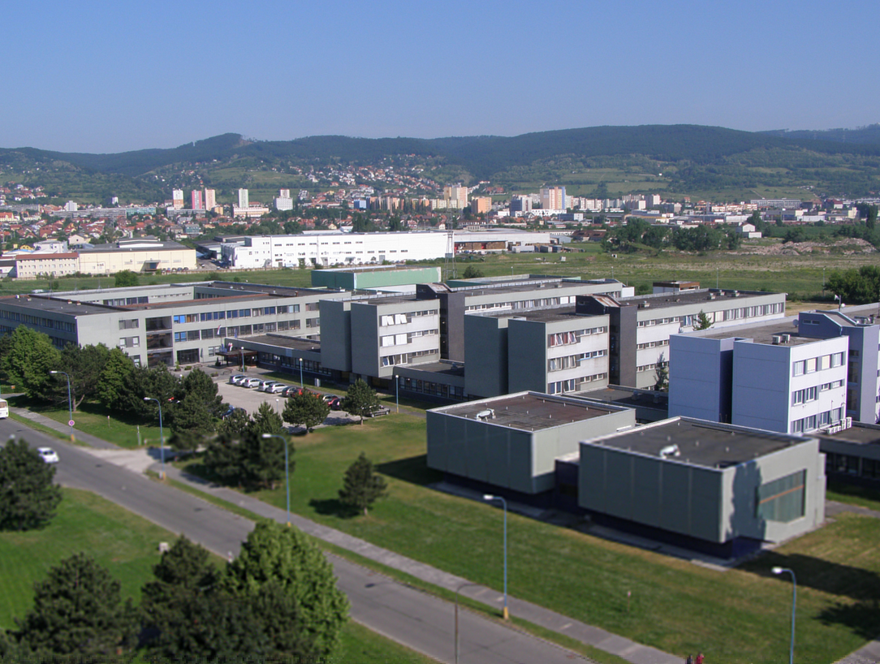

Slide 43
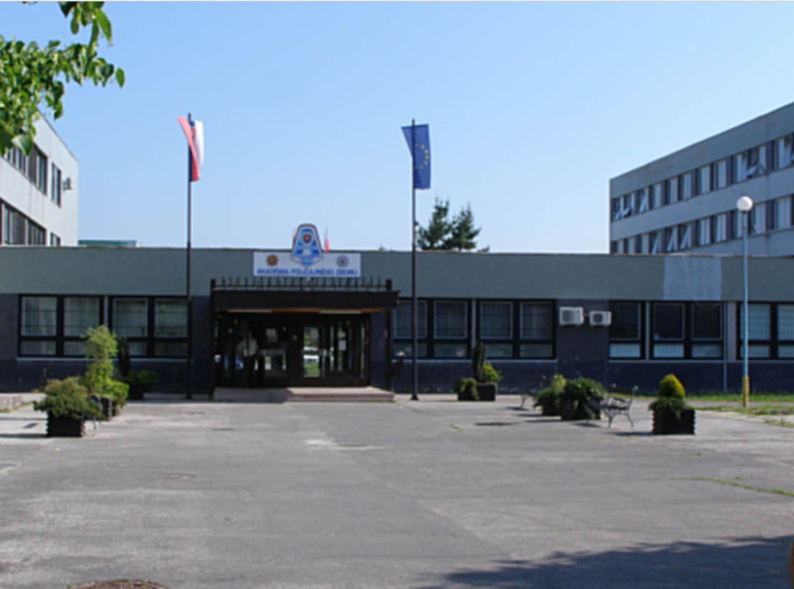

Slide 44
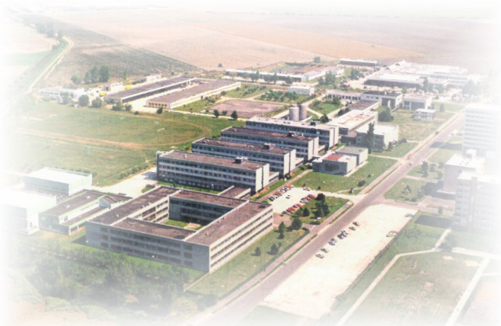
Thank you for your attention.

