Slide 1


MGR. ZUZANA MOTÚZOVÁ
CEO & PARTNER
MOTÚZOVÁ & LACKO LAW FIRM
PRACTICAL IMPLEMENTATION OF
GDPR:
NATIONAL-LEVEL HARMONISATION AND THE ROLE OF NON-STATE ACTORS
Notes:
Welcome, my name is Zuzana Motuzova, thank you for having me at this exceptional event.
I am happy and honored to be able to participate and share our practical experience and knowledge as a private sector representatives.

Slide 2


NATIONAL CONVENTION FOR EUROPEAN INTEGRATION
Working Group for Chapter 23: Judiciary and Fundamental Rights
Xheko Imperial Hotel | 15.07.2025 | 10:00 - 13:00
Notes:
I am a founder and partner of Motuzova & Lacko law firm. Our law firm specialize on information technology law, GDPR and privacy.
Represented clients regarding GDPR compliance, preparation of documentation and also in front of respective supervisory bodies.

Slide 3

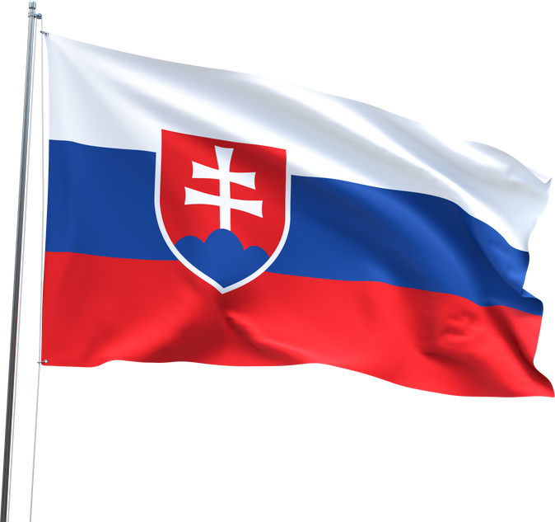

Today’s Focus
Implementation challenges and common practical gaps
The essential role of non-state actors
Real-world examples from different sectors
Recommendations and questions
Notes:
As legal advisors we have had a chance to advice our clients during proces of implementation of GDPR Directive in Slovakia and we had the opportunity to familiarize ourselves with some of the challenges of the implementation and common gaps, practical problems of private sector which I would like to share with you today.

Slide 4

Direct Applicability of GDPR
GDPR is directly applicable – often misunderstood by private and public sector resulting in:
inconsistent interpretation
insufficient compliance = more risk for legal subjects
referring to local law in documentation
= weakening of the protection of personal data of natural persons
Notes:
GDPR is one of the first regulations that is strictly directly applicable which is revolutionary.
Not all legal subject understand this - this means potential risk to private sector - mainly insufficient compliance and risk of sanctions.

Slide 5
Direct Applicability of GDPR
Some public authorities still rely on national law
less legal certainity for legal subjects and natural persons
inconsistent interpretation on local level LEADS to differences between local and EU decision making
only a few court decisions yet (even after 7 years)
Notes:
Main goal - unified and thus predictable enviroment for legal subjects

Slide 6
Slovak implementation - duplicite legislation
Act No. 18/2018 Coll., on the Protection of Personal Data and on Amendments to Certain Acts.
Covered both protection of personal data and Police Directive (Directive (EU) 2016/680)
adopted text of GDPR for situations outside the scope of Union Law + §78 (Special situations for lawful processing of personal data - employment, biometry, science, history, statistics, academics, arts & literature)
Result: uncertainty as to which legal regime should be applied
Notes:
Akademický účel, Umelecký účel, Literárny účel
Informovanie verejnosti masovokomunikačnými prostriedkami
Zamestnanci
Biometria, genetics
Ochrana práv alebo právom chránených záujmov inej osoby napr. pri oznamovaní porušenia práva
Archivácia
Vedecký výskum
Historický výskum
Štatistický účel
Situácia A: Ak pôjde o spracúvanie osobných údajov v rámci činnosti prevádzkovateľa, ktorá spadá pod právo Únie bude sa na prevádzkovateľa vzťahovať Nariadenie, uplatňovať sa ale bude aj zákon č. 18/2018 Z. z., a to s výnimkou jeho 2. a 3. časti; teda zo zákona č. 18/2018 Z. z. bude pre prevádzkovateľa relevantná prvá časť okrem § 2 a § 5 a následne štvrtá až šiesta časť zákona č. 18/2018 Z. z. Ide napríklad o spracúvanie osobných údajov bankami, školami, zdravotníckymi zariadeniami, spracúvanie osobných údajov v e-shopoch.
Situácia B: Ak pôjde o spracúvanie osobných údajov v rámci činnosti prevádzkovateľa, ktoré nespadá pod právo Únie a prevádzkovateľom nie je príslušný orgán uplatňovať sa bude zákon č. 18/2018 Z. z. okrem jeho tretej časti.
Situácia C: V prípade spracúvania osobných údajov prevádzkovateľom v postavení príslušného orgánu tento bude postupovať pri spracúvaní osobných údajov fyzických osôb na účely predchádzania trestným činom, ich vyšetrovania, odhaľovania alebo stíhania alebo na účely výkonu trestných sankcií podľa zákona č. 18/2018 Z. z. konkrétne jeho prvej časti a tretej až šiestej časti s ohľadom na niektoré ustanovenie z druhej časti. Pôjde napríklad o spracúvanie osobných údajov obvineného z trestného činu, kedy jeho osobné údaje spracúva prokuratúra alebo súd.

Slide 7
Slovak implementation - missed opportunities
Article 6 (1)(c) and (e) (compliance with legal obligations and task in public interest) + Article 23 (restriction in “public interest”)
Freedom of expression and right to information;
Public access to official documents;
Processing of data in connection with employment;
Archiving in the public interest;
Scientific or historical research;
Statistics;
Relationship to professional or legal obligations of confidentiality;
Notes:
Member States may regulate the processing of data more specifically: (i.) compliance with a legal obligation (Article 6(1)(c)), or (ii.) tasks carried out in the public interest or in the exercise of official authority (Article 6(1)(e)).
EU stat may restrict by way of a legislative measure the scope of the obligations and rights provided for in Articles 12 to 22 and Article 34, as well as Article 5 in so far as its provisions correspond to the rights and obligations provided for in Articles 12 to 22, when such a restriction respects the essence of the fundamental rights and freedoms and is a necessary and proportionate measure in a democratic society to safeguard:
(a) national security
(b) defence;
(c) public security;
(d) the prevention, investigation, detection or prosecution of criminal offences or the execution of criminal penalties, including the safeguarding against and the prevention of threats to public security;
(e) other important objectives of general public interest of the Union or of a Member State, in particular an important economic or financial interest of the Union or of a Member State, including monetary, budgetary and taxation a matters, public health and social security;
(f) the protection of judicial independence and judicial proceedings;
(g) the prevention, investigation, detection and prosecution of breaches of ethics for regulated professions;
(h) a monitoring, inspection or regulatory function connected, even occasionally, to the exercise of official authority in the cases referred to in points (a) to (e) and (g);
(i) the protection of the data subject or the rights and freedoms of others;
(j) the enforcement of civil law claims.
2. In particular, any legislative measure referred to in paragraph 1 shall contain specific provisions at least, where relevant, as to:
(a) the purposes of the processing or categories of processing;
(b)
the categories of personal data;
(c)
the scope of the restrictions introduced;
(d)
the safeguards to prevent abuse or unlawful access or transfer;
(e)
the specification of the controller or categories of controllers;
(f)
the storage periods and the applicable safeguards taking into account the nature, scope and purposes of the processing or categories of processing;
(g)
the risks to the rights and freedoms of data subjects; and
(h)
the right of data subjects to be informed about the restriction, unless that may be prejudicial to the purpose of the restriction.

Slide 8
Slovak implementation - the beginning
2018
Lack of Guidelines on local and also on EU level = Legal Uncertainty
Supervisory bodies perform controls from the beginning – but offer little interpretation
lack of experts on part of DPA
Violations found and fines imposed are easier to challenge in court (excessive or misapplied fines)
Case study: City of Rajecké Teplice vs. Slovak DPA (www.otvorenesudy.sk, Case No.: 6S/79/2020)
Notes:
City of Rajecke Teplice vs. DPA
V bezpečnostnej smernici malo mesto uvedenú dobu uchovávania osobných údajov 7 dní, avšak kamerový systém bol nastavený na uchovávanie osobných údajov počas doby 14 dní. = FORMÁLNE pochybenie, ochrana os. údajov sa míňa účinkom, nejde sa po podstate
Nebol v dokumentácii uvedený právny základ - avšak mesto skutočne spracúvalo osobné udaje ná právnom základe.

Slide 9
Slovak implementation - NKU report
Report of National Audit Office from 2020:
82% of small government bodies did not have enough funds to ensure GDPR compliance
81 % of institutions did not have financial resources to ensure GDPR requirements
Less than a 1/4 of inspected entities applied institute of DPO correctly
No national financial analysis on implementation has been conducted
No in-depth analysis of the data the state processes has been done.

Slide 10
Slovak implementation - present situation
2025
prolonged period of no DPA leadership (until recent days) (appointment by government)
DPA is Overwhelmed
Lack of IT and personal data protection experts → most important and rarest combination of expertise
lack of publication of DPA decisions
Too much focus on documentation or not actual protection

Slide 11
Slovak implementation - present situation
however...in 2025
DPA regularly publishes an inspection plan for every calendar year
New chairman of DPA - JUDr. Zuzana Valková
Key figures of the DPA regularly participate in training and conferences
new draft of a Act on protection of personal data that removes duplicate regulations and police directives
DPA provides an UI for incident reporting, annual reports, certain guidelines

Slide 12
Slovak implementation - recommendations
Prepare public for direct application of the GDPR
Provide simple, practical guidance for compliance
Ensure the availability of experts (IT + GDPR)
Focus on real (material) rather than formal data protection
Improve digital literacy and IT security awareness.
Ensure actual compliance, not formal compliance (focus on real measures)
Promote a culture of data protection and privacy

Slide 13

Non-State Actors: Who Are They?
Professional Associations and Chambers (Slovak bar association, Slovak medical Association)
Industry associations (Slovak bank association)
Certification and training bodies (Cyber security compenence and certification centre - cybercompetence.sk)
Law firms and individual experts
Private companies implementing “privacy by design”
Notes:
1. Taking into account the state of the art, the cost of implementation and the nature, scope, context and purposes of processing as well as the risks of varying likelihood and severity for rights and freedoms of natural persons posed by the processing, the controller shall, both at the time of the determination of the means for processing and at the time of the processing itself, implement appropriate technical and organisational measures, such as pseudonymisation, which are designed to implement data-protection principles, such as data minimisation, in an effective manner and to integrate the necessary safeguards into the processing in order to meet the requirements of this Regulation and protect the rights of data subjects.
2. The controller shall implement appropriate technical and organisational measures for ensuring that, by default, only personal data which are necessary for each specific purpose of the processing are processed. That obligation applies to the amount of personal data collected, the extent of their processing, the period of their storage and their accessibility. In particular, such measures shall ensure that by default personal data are not made accessible without the individual's intervention to an indefinite number of natural persons.

Slide 14
Real Examples from Slovakia
EPI GDPR conference and Act on the Protection of Personal Data (www.profivzdelavanie.sk)
Slovak Association for Personal Data Protection: awareness campaigns (www.soou.sk),
Data privacy and Security day 2024 (1st year) (dpday.sk)
DPO of the Year (organized by Slovak Association of Personal Data protection)

Slide 15

Certification & Codes of Conduct
GDPR allows sector-specific codes of conduct (Art. 40)
Also enables certification mechanisms (Art. 42–43) (europrivacy.com)
BUT → Rarely used in practice
Slovak Bar Association - one and only DPA approved Code of Conduct in Slovakia (https://www.sak.sk/web/sk/cms/news/form/link/display/621/_event)
Slovak Bank Association (non-binding character)

Slide 16

Data Minimisation
Less Is More: Collect Only What You Need
GDPR Art. 5(1)(c)
Data must be adequate, relevant, and limited
Sector challenges:
ecommerce → colection of national ID numbers, social media tracking
employment sector → criminal record extract, photography of National IDs, biometry, work attendance
marketing → cookies, user tracking

Slide 17

The Right to Be Forgotten
One of the most challenging rights
GDPR Art 17 – Right to erasure (‘right to be forgotten’)
Limitations
Can’t erase if data needed for legal claims, taxation, etc.
technical challenges (third party cooperation)
Sector challenges
uncertainty about which data the processor can keep

Slide 18
DPIAs (Art. 35 GDPR) and prior consultations (Art. 36 GDPR)
Decree No. 158/2018, Coll., on the procedure for assessing the impact on the protection of personal data
When required?
Automated decision-making, including profiling
Large-scale processing of sensitive data (e.g. health data, criminal records)
Systematic surveillance of public spaces on a large scale
Prior Consultation - DPIA indicates that data processing means high risk for data subject (cameras in schools)

Slide 19
Recommendations
What We Need Going Forward
Simplify compliance for small controllers (e.g. schools, NGOs)
Strengthen DPA capacity (especially IT know-how)
Promote certification and sectoral codes
Empower non-state actors with funding + legal access
Prioritise real protection over checklists

Slide 20


Thank You & Q&A :)
Let’s Keep the Conversation Going
motuzova@akmotuzova.sk
+421 902 203 238

