Slide 1

Doing Business – EU main policies and best practises from Slovakia
Adriána Valášková 17.6.2022

Slide 2

REGIONAL AND EU POLICIES FOR ENTREPRENEURSHIP
The European Green Deal - The new Industrial Strategy for Europe
Programme "Better Regulation„
EU actions based on evidence
Making simpler and better EU laws
Involving citizens, businesses and stakeholders in the decision-making process
RIA 2020 - Strategy for better regulation
optimize the regulatory environment and increase the transparency of all legislation and non-legislative documents, and secondarily to improve the business environment

Slide 3
BARRIERS TO DOING BUSINESS
National Expert Survey
administrative complexity
regulations related to business
low competitiveness

Slide 4
HOW DOES MINISTRY OF ECONOMY OF THE SLOVAK REPUBLIC HELP TO IMPROVE BUSINESS ENVIRONMENT?

Slide 5
TWO BETTER REGULATION TOOLS
1in2out principle
ex post evaluation
results from:
MANIFESTO OF THE GOVERNMENT OF THE SLOVAK REPUBLIC (2021);
Component No. 14 of the RECOVERY AND RESILIENCE PLAN OF THE SLOVAK REPUBLIC

Slide 6
RECOVERY AND RESILIENCE PLAN OF THE SLOVAK REPUBLIC
4 commitments:
the 1in1out/1in2out principle
ex post evaluation for legislative and non-legislative materials
protection against unjustified goldplating
antibureaucratic packages – burden reduction activities

Slide 7
RECOVERY AND RESILIENCE PLAN OF THE SLOVAK REPUBLIC
4 commitments:
the 1in1out/1in2out principle
ex post evaluation for legislative and non-legislative materials
protection against unjustified goldplating
antibureaucratic packages – burden reduction activities

Slide 8
PRINCIPLE 1IN2OUT
mechanism to reduce bureaucracy and costs
principle 1in1out/1in2out

Slide 9
THE UNIFIED METHODOLOGY FOR THE ASSESSMENT OF SELECTED IMPACTS
1in2out principle is incorporated in this Unified Methodology.
The Unified Methodology sets out a procedure for regulators to assess the impact of materials that are about to be submitted to the process of commenting.

Slide 10
MECHANISM TO REDUCE BUREAUCRACY AND COSTS
introduced in the Slovak Republic on June 1, 2021
the basis of the principle is monetary
if a regulator introduces (in ex ante phase) new costs to business, he is obliged to reduce existing costs in the same amount
1 € IN – 1 € OUT (transitional period)

Slide 11
MECHANISM TO REDUCE BUREAUCRACY AND COSTS
the principle 1in2out is valid since January 1, 2022
1 € IN – 2 € OUT
main goal – improve the business environment, increase competitiveness and productivity of the entrepreneurs

Slide 12
Business impact analysis
Regulation costs
TYPES OF COSTS | Costs increase in € |  | Costs decrease in €
A. Taxes, levies, duties and charges aimed at reducing negative externalities | 0,00 |  | 0,00
B. Other charges | 0,00 |  | 0,00
C. Indirect financial costs | 0,00 |  | 0,00
D. Administrative costs | 0,00 |  | 0,00
Overall = A+B+C+D | 0,00 |  | 0,00
There of
E. Impact on SME | 0,00 |  | 0,00
F. Full harmonization of EU law | 0,00 |  | 0,00
Quantification of the principle 1in2out: | IN |  | OUT
G. Costs with exceptions = B+C+D-F | 0,00 |  | 0,00
Notes:
Vysvetlenie ako sa kopírujú tabuľky z KN do AVnaPP

Slide 13
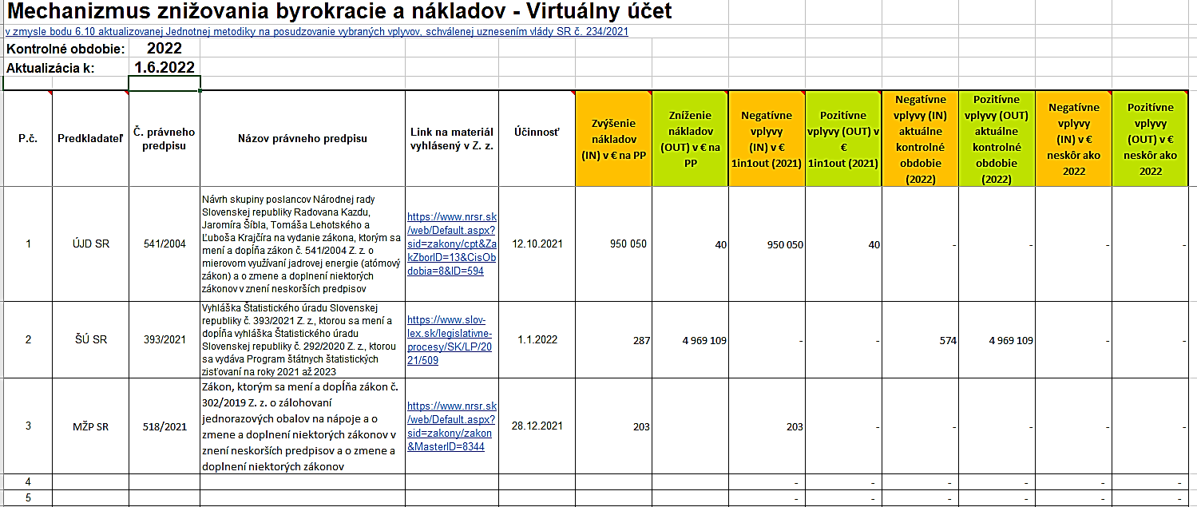
VIRTUAL ACCOUNTS

Slide 14
CONSULTATIONS WITH BUSINESS ENVIRONMENTS
regulators are obliged to realize consultations with entrepreneurs or with their representatives
the process of these consultations is before the process of commenting
in Business impact analysis regulators evaluate this consultations
Notes:
Vysvetlenie ako sa kopírujú tabuľky z KN do AVnaPP

Slide 15
BUSINESS ACTORS AND THEIR ROLE DURING CONSULTATIONS
for every consultation are invited those business entities that are directly affected by the prepared material
their role is to agree or disagree with the material, to emphasize which parts they do not agree with and to suggest possible solutions
team 1in2out also contacts entrepreneurs and their representatives during the process of assessing the impact on the business environment of a particular material
Notes:
Vysvetlenie ako sa kopírujú tabuľky z KN do AVnaPP

Slide 16
BUSINESS ACTORS AND THEIR ROLE DURING CONSULTATIONS
business representatives:
SBA – Slovak Business agency - the oldest specialized non-profit organization for the support of small and medium-sized enterprises (SMEs)
Club 500 - non-profit association founded by Slovak owners and co-owners of companies employing more than 500 employees
Entrepreneurs Assocation of Slovakia - whose main mission is to improve the business environment in our country.
Federation of employers' associations of the Slovak Republic - the supreme employers’ organisation in the Slovak Republic. Its members include business’ and employers’ associations.
Notes:
Vysvetlenie ako sa kopírujú tabuľky z KN do AVnaPP

Slide 17
COMPETITIVENESS AND PRODUCTIVITY
the regulator evaluates in Business Impact Analysis how its material affects competitiveness and productivity
The Council of the Government of the Slovak Republic for Competitiveness and Productivity
Its basic task is to monitor, analyze and evaluate productivity and competitiveness in the Slovak Republic, especially in the business environment, innovation, foreign trade, education and efficient public administration.
Notes:
Vysvetlenie ako sa kopírujú tabuľky z KN do AVnaPP

Slide 18
RECOVERY AND RESILIENCE PLAN OF THE SLOVAK REPUBLIC
4 commitments:
the 1in1out/1in2out principle
ex post evaluation for legislative and non-legislative materials
protection against unjustified goldplating
antibureaucratic packages – burden reduction activities

Slide 19
EX POST EVALUATION
established this year on June 10, 2022
result in a statement, whether the regulation is fit for purpose and therefore may remain without any amendments, or it needs to be fixed or even cancelled
two types of ex post evaluation:
in depth evaluation, that will be carried out by our Ministry in synergy with regulators
systematic ex post evaluation of regulations that will comprise elements of post-implementation reviews, based on a comparison of real impacts expected in the ex ante phase
Notes:
Vysvetlenie ako sa kopírujú tabuľky z KN do AVnaPP

Slide 20
EX POST EVALUATION
established this year on June 10, 2022
result in a statement, whether the regulation is fit for purpose and therefore may remain without any amendments, or it needs to be fixed or even cancelled
two types of ex post evaluation:
in depth evaluation, that will be carried out by our Ministry in synergy with regulators
systematic ex post evaluation of regulations that will comprise elements of post-implementation reviews, based on a comparison of real impacts expected in the ex ante phase
Notes:
Vysvetlenie ako sa kopírujú tabuľky z KN do AVnaPP

Slide 21
RECOVERY AND RESILIENCE PLAN OF THE SLOVAK REPUBLIC
4 commitments:
the 1in1out/1in2out principle
ex post evaluation for legislative and non-legislative materials
protection against unjustified goldplating
antibureaucratic packages – burden reduction activities

Slide 22
PROTECTION AGAINST UNJUSTIFIED GOLDPLATING
The use of goldplating in the transposition or implementation of EU legislation is, in principle undesirable.
The submitter should not go beyond the minimum required framework as such the procedure may lead to a reduction in the competitiveness of domestic enterprises in comparison with companies from countries where the legislation is not so strict.
Use of goldplating is therefore only admissible in duly justified exceptional cases and explained in the impact analysis, consulted with the entrepreneurs concerned and assessed by the Commission.
Notes:
Vysvetlenie ako sa kopírujú tabuľky z KN do AVnaPP

Slide 23
RECOVERY AND RESILIENCE PLAN OF THE SLOVAK REPUBLIC
4 commitments:
the 1in1out/1in2out principle
ex post evaluation for legislative and non-legislative materials
protection against unjustified goldplating
antibureaucratic packages – burden reduction activities

Slide 24
ANTIBUREAUCRATIC PACKAGES – BURDEN REDUCTION ACTIVITIES
Burden reduction activities are about introducing several packages of measures to improve the business environment.
Antibureacratic package no.1 – 2020
115 measures
Antibureacratic package no. 2 – 2022
198 measures
Antibureacratic package no. 3 – in the preparatory phase

Slide 25
ANTIBUREAUCRATIC PACKAGES – EXAMPLES OF THE MEASURES
Abolition of the obligation to have a complaint procedure in retail and catering establishments.
Establishment of the electronic form of the invoice as preferred for
legal persons in relation to telecommunications services.
Introducing the possibility for driving schools to teach through e-learning.
Renewal of the original vehicle registration certificate 10 years for unlimited validity.

Slide 26
ANTIBUREAUCRATIC PACKAGES
These measures are selected on the basis of what we perceive in the legislative process to be often commented on from the point of view of entrepreneurs.
However, entrepreneurs can also send their suggestions for the measures that should be included in these packages via the form on the website of our ministry.

Slide 27
THANK YOU FOR YOUR ATTENTION
CONTACT: adriana.valaskova@mhsr.sk

